Slide 1

Java
By: Sudhaker Reddy Teegala

Slide 2
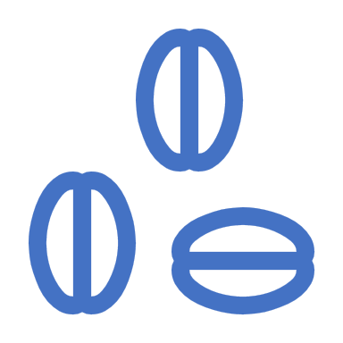
Overview
Java 1.0 to 1.4
Java 1.5 to 1.7
Java 8
Java 9
Java 10
Java 11
Why upgrade from JDK 8 to JDK 11?
Oracle Java SE Support Roadmap
Open JDK & Oracle JDK

Slide 3
Java 1.0 to 1.4
Java 1.0
Was called as Oak
Java 1.1(1997)
Inner Classes were added
Java Beans were introduced.
JDBC
RMI
Reflections
JIT
Internationalization
Java 1.2(1998)
Renamed to J2SE
Collections API was added.
Swings were introduced.
Strictfp keyword was added
Java 1.3(2000)
Hotspot JVM
JNDI
Java 1.4(2002)
Ipv6 support
Regular Expressions
Assert keyword

Slide 4
Java 1.5 to 1.7
2005
Java 1.5
Renamed as J2SE 5.0
Generics
Auto boxing
Varargs
Enhanced for loop
Static imports
Enumerations
2006
Java 1.6
Renamed as Java SE 6
JDBC 4
2011
Java 1.7
Strings in switch keyword
Try with resources(automatic closing of resources without using finally block)
No need to declare data type in the RHS of collections declarations.

Slide 5
Java 8(2014)
1. Lambda Expression
2. Method references
3. Functional Interface
4. Default Methods
5. Streams
6. Date/Time API Changes
7. Optional Class
8. Static methods in Interface

Slide 6
Lambda Expressions: Iterating over List
//Prior Java 8 :
List features = Arrays.asList("Lambdas", "Default Method", "Stream API", "Date and Time API");
for (String feature : features) {
System.out.println(feature);
}
//In Java 8:
List features = Arrays.asList("Lambdas", "Default Method", "Stream API", "Date and Time API");
features.forEach(n -> System.out.println(n));
Output:
Lambdas
Default Method
Stream API
Date and Time API
// Even better use Method Reference feature of Java 8
// method reference is denoted by :: (double colon) operator
// looks similar to score resolution operator of C++
features.forEach(System.out::println);

Slide 7
Method Reference:
Double colon i.e. :: operator is introduced in Java 8 as a method reference. Method reference is a form of lambda expression which is used to refer the existing method by its name.
Syntax: classname::methodName
Example:-
stream.forEach(element -> System.out.println(element))
By using Double Colon ::
stream.forEach(System.out::println(element))

Slide 8
Functional Interface:
Example 1:
@FunctionalInterface
public interface MyFirstFunctionalInterface {
public void firstWork();
} //Valid
Example 2:
@FunctionalInterface
public interface MyFirstFunctionalInterface {
public void firstWork();
public void doSomeMoreWork(); //error
} //Invalid
Compile time error:
Unexpected @FunctionalInterface annotation @FunctionalInterface ^ MyFirstFunctionalInterface is not a functional interface multiple non-overriding abstract methods found in interface MyFirstFunctionalInterface

Slide 9
Functional Interfaces: Do’s and Don'ts:
Below is list of things which are allowed and which are not in a functional interface.
As discussed above, only one abstract method is allowed in any functional interface. Second abstract method is not permitted in a functional interface. If we remove @FunctionalInterface annotation then we are allowed to add another abstract method, but it will make the interface non-functional interface.
A functional interface is valid even if the @FunctionalInterface annotation would be omitted. It is only for informing the compiler to enforce single abstract method inside interface.
Conceptually, a functional interface has exactly one abstract method. Since default methods have an implementation, they are not abstract. Since default methods are not abstract you’re free to add default methods to your functional interface as many as you like.

Slide 10
Default Method:
public interface Interface1 {
void method1(String str);
default void log(String str){
System.out.println("Default Method" + str);
}
}

Slide 11
Streams: Creating Streams
Example 1: Stream.of()
public class StreamBuilders {
public static void main(String[] args) {
Stream<Integer> stream = Stream.of(1,2,3,4,5,6,7,8,9);
stream.forEach(p -> System.out.println(p));
}
}
Example 2: List.stream()
public class StreamBuilders {
public static void main(String[] args) {
List<Integer> list = new ArrayList<Integer>();
for(int i = 1; i< 10; i++){
list.add(i);
}
Stream<Integer> stream = list.stream();
stream.forEach(p -> System.out.println(p));
}
}

Slide 12
Stream Operations: Intermediate Operations
Intermediate operations return the stream itself so you can chain multiple methods calls in a row. Let’s learn important ones.
Example: Stream.filter():
memberNames.stream().filter((s) -> s.startsWith("A")).forEach(System.out::println);
Other Intermediate Operations:
map()
flatMap()
distinct()
sorted()
peek()
limit()
skip()

Slide 13
Stream Operations: Terminal operations
Terminal operations return a result of a certain type after processing all the stream elements.
Once the terminal operation is invoked on a Stream, the iteration of the Stream and any of the chained streams will get started. Once the iteration is done, the result of the terminal operation is returned.
Example: Stream.forEach()
memberNames.forEach(System.out::println);
Other Terminal Operations:
forEach()
forEachOrdered()
toArray()
reduce()
collect()
min()
max()
count()
anyMatch()
allMatch()
noneMatch()
findFirst()
findAny()

Slide 14
Date and Time Examples:
The new classes intended to replace Date class are LocalDate, LocalTime and LocalDateTime.
LocalDate:
The LocalDate class represents a date. There is no representation of a time or time-zone.
LocalDate localDate = LocalDate.now();
System.out.println(localDate.toString()); //2013-05-15
System.out.println(localDate.getDayOfWeek().toString()); //WEDNESDAY
System.out.println(localDate.getDayOfMonth()); //15
System.out.println(localDate.getDayOfYear()); //135
System.out.println(localDate.isLeapYear()); //false
System.out.println(localDate.plusDays(12).toString()); //2013-05-27

Slide 15
Date and Time Examples:
LocalTime:
The LocalTime class represents a time. There is no representation of a date or time-zone.
//LocalTime localTime = LocalTime.now(); //toString() in format 09:57:59.744
LocalTime localTime = LocalTime.of(12, 20);
System.out.println(localTime.toString()); //12:20
System.out.println(localTime.getHour()); //12
System.out.println(localTime.getMinute()); //20
System.out.println(localTime.getSecond()); //0
System.out.println(localTime.MIDNIGHT); //00:00
System.out.println(localTime.NOON); //12:00

Slide 16
Date and Time Examples:
LocalDateTime:
The LocalDateTime class represents a date-time. There is no representation of a time-zone.
LocalDateTime localDateTime = LocalDateTime.now();
System.out.println(localDateTime.toString()); //2013-05-15T10:01:14.911
System.out.println(localDateTime.getDayOfMonth()); //15
System.out.println(localDateTime.getHour()); //10
System.out.println(localDateTime.getNano()); //911000000

Slide 17
Date and Time Examples:
Other new classes to represent timestamp and duration
Instant:
For representing the specific timestamp ant any moment, the class needs to be used is Instant. The Instant class represents an instant in time to an accuracy of nanoseconds. Operations on an Instant include comparison to another Instant and adding or subtracting a duration.
Instant instant = Instant.now();
System.out.println(instant.toString()); //2013-05-15T05:20:08.145Z
Duration:
Duration class is a whole new concept brought first time in java language. It represents the time difference between two time stamps.
Duration duration = Duration.ofMillis(5000);
System.out.println(duration.toString()); //PT5S
Period:
To interact with human, you need to get bigger durations which are presented with Period class.
Period period = Period.ofDays(6);
System.out.println(period.toString()); //P6D

Slide 18
Java 9(Sept 2017)
Jshell(REPL)
Factory Methods for Immutable List, Set, Map and Map.Entry
Private methods in Interfaces
Stream API Improvements
Stream of Dates
Modules(Project Jigsaw)
Try With Resources Improvement
Optional Class Improvements
Enhanced @Deprecated annotation
HTTP 2 Client

Slide 19
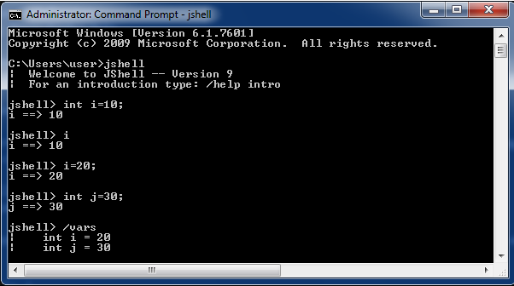
Jshell (REPL)
JShell is new command line interactive REPL (Read-Evaluate-Print-Loop) console shipped with JDK 9 distribution to evaluate declarations, statements and expressions written in Java. Jshell allows to create small code snippets and test them without requiring to create and build a complex project. And that’s how it should be used. Working on JShell is kept easy to make it usable and fast.
Variables:
You can define variables just like you do in real programming. Only difference is that you don’t have to write a class or main method to start with.

Slide 20
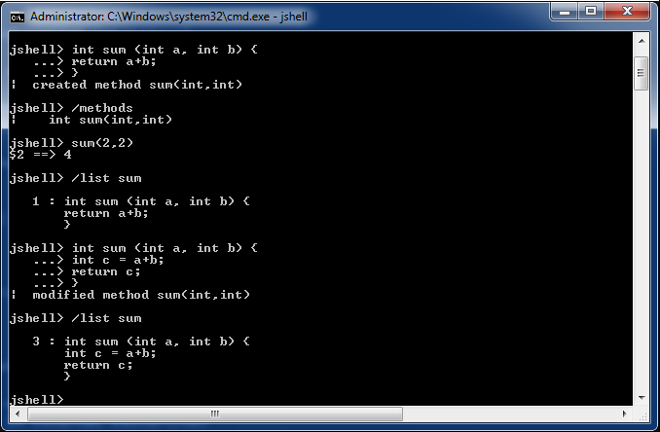
Jshell (REPL):
Methods:
To create method in jshell, define method with return type, method name, parameters and method body. Access modifiers are not required.

Slide 21
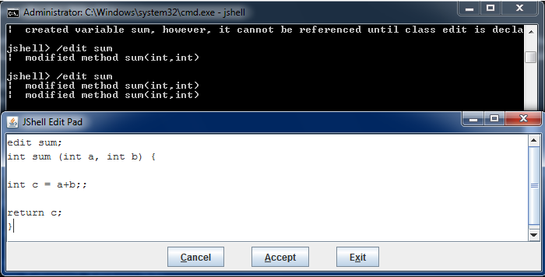
Jshell (REPL):
Edit Code in JShell Edit Pad:
To launch edit pad, use /edit command with method name.

Slide 22
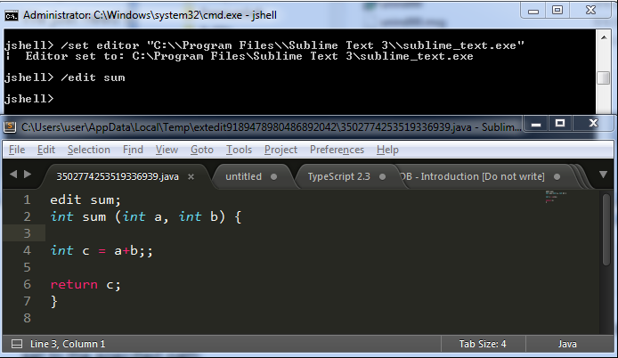
Jshell (REPL):
Launch Code in External Editor:
JShell allows to easily configure any external editor to edit the code snippets. You just need to get the complete path to the editor we want to use and run /set editor command in JShell to configure the editor.

Slide 23
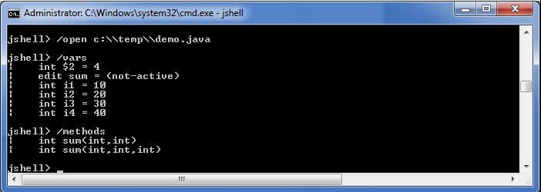
Jshell (REPL):
Load Code from External Java File into REPL:
To load file in JShell, use /open command.

Slide 24
Immutable Collections with Factory Methods:
We can create immutable collections such as immutable list, immutable set and immutable map using new factory methods in Java 9.
Example:
public class ImmutableCollections {
public static void main(String[] args) {
List<String> names = List.of("Lokesh", "Amit", "John");
//Preserve the elements order
System.out.println(names);
//names.add("Brian"); //UnsupportedOperationException occured
//java.lang.NullPointerException
//List<String> names2 = List.of("Lokesh", "Amit", "John", null);
}
}
Output: [Lokesh, Amit, John]

Slide 25
Private Methods in Interface:
Java 9 onward, you are allowed to include private methods in interfaces. Using private methods, now encapsulation is possible in interfaces as well.
Since java 9, you will be able to add private methods and private static method in interfaces.
These private methods will improve code re-usability inside interfaces. For example, if two default methods needed to share code, a private interface method would allow them to do so, but without exposing that private method to its implementing classes.
Using private methods in interfaces have four rules:
Private interface method cannot be abstract.
Private method can be used only inside interface.
Private static method can be used inside other static and non-static interface methods.
Private non-static methods cannot be used inside private static methods.

Slide 26
Private Methods in Interface: Example:
import java.util.function.IntPredicate;
import java.util.stream.IntStream;
public interface CustomCalculator {
default int addEvenNumbers(int... nums) {
return add(n -> n % 2 == 0, nums);
}
default int addOddNumbers(int... nums) {
return add(n -> n % 2 != 0, nums);
}
private int add(IntPredicate predicate, int... nums) {
return IntStream.of(nums)
.filter(predicate)
.sum();
}
}

Slide 27
Stream API Improvements:
1. Limiting Stream with takeWhile() and dropWhile() methods:
List<String> alphabets = List.of("a", "b", "c", "d", "e", "f", "g", "h", "i");
List<String> takeWhileSubset = alphabets
.stream()
.takeWhile(s -> !s.equals("d"))
.collect(Collectors.toList());
System.out.println(takeWhileSubset);
List<String> dropWhileSubset = alphabets
.stream()
.dropWhile(s -> !s.equals("d"))
.collect(Collectors.toList());
System.out.println(dropWhileSubset);
Output:
[a, b, c]
[d, e, f, g, h, i]

Slide 28
Stream API Improvements:
2. Overloaded Stream iterate method:
//Java8
List<Integer> numbers = Stream.iterate(1, i -> i+1)
.limit(10)
.collect(Collectors.toList());
//Java9
List<Integer> numbers = Stream.iterate(1, i -> i <= 10 ,i -> i+1)
.collect(Collectors.toList());
System.out.println(numbers);
Output:
[1, 2, 3, 4, 5, 6, 7, 8, 9, 10] //Both gives same output

Slide 29
Stream API Improvements:
3. New Stream ofNullable() method:
Stream<String> stream = Stream.ofNullable("123");
System.out.println(stream.count());
stream = Stream.ofNullable(null);
System.out.println(stream.count());
Output:
1
0

Slide 30
Stream of Dates:
public class Java9StreamExamples {
public static void main(String[] args) {
System.out.println( getDaysInJava9(LocalDate.now(), LocalDate.now().plusDays(10)) );
System.out.println( getDaysInJava9Weeks(LocalDate.now(), LocalDate.now().plusWeeks(10)) );
}
//Stream of dates with 1 day difference
public static List<LocalDate> getDaysInJava9(LocalDate start, LocalDate end) {
return start.datesUntil(end).collect(Collectors.toList());
}
//Stream of dates with 1 week difference
public static List<LocalDate> getDaysInJava9Weeks(LocalDate start, LocalDate end) {
return start.datesUntil(end, Period.ofWeeks(1)).collect(Collectors.toList());
}
}
Output:
[2017-07-31, 2017-08-01, 2017-08-02, 2017-08-03, 2017-08-04, 2017-08-05, 2017-08-06, 2017-08-07, 2017-08-08, 2017-08-09]
[2017-07-31, 2017-08-07, 2017-08-14, 2017-08-21, 2017-08-28, 2017-09-04, 2017-09-11, 2017-09-18, 2017-09-25, 2017-10-02]

Slide 31
Java 10(Mar 2018)
Local-Variable Type Inference
Time-Based Release Versioning
Experimental Java-Based JIT Compiler
Parallel Full GC for G1
Garbage-Collector Interface
Additional Unicode Language-Tag Extensions
Thread-Local Handshakes

Slide 32
Local-Variable Type Inference:
When you are using var to declare the variable, basically, instead of declaring a variable type, it assumes its type from what it is being set to.
Example:
var str = "Hello world";
//or
String str = "Hello world";
When using var, you must initialize the variable at same place.
var i; //Invalid Declaration - - Cannot use 'var' on variable without initializer
var j = 10; //Valid Declaration
var var = 10; //Valid Declaration
int var = 10; //Also valid Declaration
Usage of 'var' allowed as :
Local variables with initializers
Indexes in the enhanced for-loop
Locals declared in a traditional for-loop

Slide 33
Time-Based Release Versioning:
COUNTER NAME | DESCRIPTION
$FEATURE | It will be incremented every 6 months and based on feature release versions e.g: JDK 10, JDK 11. (Formerly $MAJOR.)
$INTERIM | Usually this will be zero, as there will be no interim release in a six month period. It will be incremented for non-feature releases that contain compatible bug fixes and enhancements but no incompatible changes, no feature removals, and no changes to standard APIs. (Formerly $MINOR.)
$UPDATE | It will be incremented for compatible update releases that fix security issues, regressions, and bugs in newer features. (Formerly $SECURITY.)
$PATCH | It will be incremented only when it’s necessary to produce an emergency release to fix a critical issue.
If you run command java -version in command prompt/terminal then you will get version information like this:
C:\Users\Sudhaker>java -version
java version "10.0.1" 2018-04-17
Java(TM) SE Runtime Environment 18.3 (build 10.0.1+10)
Java HotSpot(TM) 64-Bit Server VM 18.3 (build 10.0.1+10, mixed mode)
The new format of the version number is:
$FEATURE.$INTERIM.$UPDATE.$PATCH

Slide 34
Time-Based Release Versioning:
Java Version API:
Runtime.version() can be used to get version counter values programmatically.
Example:
Version version = Runtime.version();
// Version version = Runtime.Version.parse("10.0.1");
version.feature();
version.interim();
version.update();
version.patch();
Output:
10
0
1
0

Slide 35
Java 11(Sept 2018)
Running Java File with single command
Scripting Using java
Local Variable syntax for Lambda expression
Java String Methods like repeat, isBlank(), strip, lines

Slide 36
Major new features in Java 11
Launching Single-file Source-Code: If I say write a java program we follow the below steps.
Example:
public class HelloUniverse{
public static void main(String[] args) {
System.out.println("Hello Universe");
}
}
Before Java 11:
Compile:$javac HelloUniverse.java
Run:$java HelloUniverse
O/p:Hello Universe
In Java 11:
Run:$java HelloUniverse.java
O/p:Hello Universe

Slide 37
Major new features in Java 11
Scripting Using java: Using shebang(“#!”), we can develop executable javascript and run from the command line.
Example:
./listallfiles
#!/usr/bin/java --source 11
import java.nio.file.*;
public class ListFiles {
public static void main (String ... args) throws Exception
{
Files.walk(Path.get(args[0])).forEaach(System.out::println);
}
}
How to Run:
$chmod +x listallfiles
$./listallfiles . // Here "." is a current directory.

Slide 38
Language & Library Improvements:
Local Variable syntax for Lambda expression: Use var in lambdas
Before Java 11: We were using explicit type in a lambda expression.
// Any local variable declaration
List<String> list = new ArrayList<String>();
Stream<String> stream = getStream()
// For Lambda Expression.
(String a, String b) -> a.concat(b)
Java 11: Can use var in lambda expression without using an explicit type.
// Any local variable declaration.
var list = new ArrayList<String>();
var stream = getStream();
// For Lambda Expression.
(var a, var b) -> a.concat(b)

Slide 39
Language & Library Improvements:
HttpClient API:
The HTTP Client was replaced with java.net.HttpURLConnection in Java 11. It can be used to request HTTP resources over the network. It supports HTTP/1.1 and HTTP/2, both synchronous and asynchronous programming models, handles request and response bodies as reactive-streams, and follows the familiar builder pattern.
Example: GET request that prints the response body as a String
HttpClient client = HttpClient.newHttpClient();
HttpRequest request = HttpRequest.newBuilder()
.uri(URI.create("http://openjdk.java.net/"))
.build();
client.sendAsync(request, BodyHandlers.ofString())
.thenApply(HttpResponse::body)
.thenAccept(System.out::println)
.join();

Slide 40
Language & Library Improvements:
Library Improvements: Added a few methods in String library like “repeat”, isBlank(), strip, lines.

Slide 41
Language & Library Improvements:
Nest based access control: nests allow nested classes to be compiled to different class files that belong to the same enclosing class. These are then allowed to access each other’s private classes without the use of synthetic/bridge methods.

Slide 42
Performance & Security Improvements
Garbage Collector Improvements: Java manages heap memory for you. You run your application inside a virtual machine (JVM). The JVM does the work of allocating space when necessary and freeing it when it is no longer needed. The garbage collector (GC) is what does this work for you. Recycling memory involves garbage collection “cycles” that have an impact on performance.
G1 GC is a default Garbage collector since Java 9. After incremental improvement GC in Java 11 is 60% better than earlier.
Java 11 introduced Epsilon and the Z garbage collector (ZGC) and we can pick up better-suited GC for our application.
Security improvements: TLS 1.3: Now TLS 1.3 implemented in JDK. Older legacy algorithms pruned and all handshake algorithm except the message is encrypted.

Slide 43
Deprecations & Removals
Removed Java EE and CORBA modules from JDK.
Removed Thread.destroy() and Thread.stop() methods.
Removed Applets and Java Web Start.

Slide 44
Why upgrade from JDK 8 to JDK 11?
Next LTS version (if you own a commercial license).
Oracle no longer offers JRE and Server JRE downloads; consequently, Auto-Update is not available anymore.
Oracle no longer provides a 32-bit Windows download.
Java Applet, Java Web Start, Java Plugin, and Java Control Panel are not available in JDK. See Removal of the Deployment Stack.
JavaFX is no longer included in the JDK. It is now available as a separate download from https://openjfx.io/.
JAXB and JAX-WS are no longer bundled with JDK. See Removal of Java EE and CORBA Modules.
Support parallel full garbage collection on G1.
Free Application Class-Data Sharing feature.
Free low overhead Flight Recorder and Heap Profiler.
Heap allocation on alternative memory devices.
New ZGC and Epsilon garbage collectors.
Transport Layer Security (TLS) 1.3.
JShell.
Support for “shebang” Java files! #!/bin/java
Deprecations & removals of Library
API updates

Slide 45
LTS: Long Term Support
Oracle Java SE Support Roadmap*†
Release | GA Date | Premier Support Until | Extended Support Until | Sustaining Support
7 | July 2011 | July 2019 | July 2022***** | Indefinite
8﻿** | March 2014 | March 2022 | December 2030 | Indefinite
9 (non‑LTS) | September 2017 | March 2018 | Not Available | Indefinite
10 (non‑LTS) | March 2018 | September 2018 | Not Available | Indefinite
11 (LTS) | September 2018 | September 2023 | September 2026 | Indefinite
12 (non‑LTS) | March 2019 | September 2019 | Not Available | Indefinite
13 (non‑LTS) | September 2019 | March 2020 | Not Available | Indefinite
14 (non‑LTS) | March 2020*** | September 2020 | Not Available | Indefinite
15 (non‑LTS) | September 2020*** | March 2021 | Not Available | Indefinite

Slide 46
Open JDK & Oracle JDK
Both have the same features. Open JDK is an open-source and Oracle JDK java proprietary license. Till Java 10, can use Open JDK & Oracle JDK in production free of charge but from Java 11, we can only use Open JDK as free but not Oracle JDK in production.
Few important points about LTS.
Every year, 2 releases from Java until 2028(Java 31).
Long Term Support Release for every 3 years. So after Java 8, next LTS is Java 11.
3-year support commitment is minimum. and LTS is only applying for Oracle JDK. We can buy support for Java 11 for more than 3 years also.
All Open JDK have only 6-month support until then next major release. So either you buy LTS support or switch every six-month releases.

Slide 47

THANK YOU
KUDOS JAVA

